Slide 1



Looking for Threat: Examining Whether Infant Attention Bias and Temperament Are Longitudinally Associated with Childhood Anxiety
FRANCES DOYLE, CHLOE GOLDSMITH & SAMUDRA RADHAKRISHNAN

Slide 2
Cohorts from infancy with children and their mothers
Socio-emotional attention
Mother-child interactions
Psycho-physiology
Notes:
… want to understand these developmental processes and also understand how they may relate to the development of mental health problems in childhood.

Slide 3
Background
Anxiety disorders
  Risk of negative outcomes across the lifespan, including:
    Impaired social relationships (Christina et al., 2021)
    Reduced academic engagement and performance (Goodsell et al., 2017)
    Poorer physical health (Copeland et al., 2014)
    Diminished quality of life (Dickson et al., 2024)
Notes:
Anxiety disorders are the most common childhood mental health disorders with approximately 1 in 10 of youth experiencing an anxiety disorder in a 12-month period.
Anxiety disorders tend to develop early in life and are among the first disorders to appear, with specific phobias and separation anxiety among the first anxiety disorders to emerge (Rapee et al., 2023).
If left untreated, anxiety disorders tend to persist into adulthood and have a lifelong impact.
Youth with anxiety disorder have considerable functional life impairments, including in peer relationships, and academic performance.
Whilst there are a range of gold-standard treatments available for childhood anxiety disorders, we still find that only 50-60% children no longer are in the clinical group following treatment.
Therefore, we still need to further understand the development of anxiety disorders and the possible mechanisms that could be targeted to improve future treatments.

Slide 4
Background
Socio-emotional attention patterns
Attention bias towards threat
Heightened tendency to detect perceived threats
Difficulty disengaging from perceived threats
Infant literature
Findings have been mixed
Reliance on cross-sectional studies
Possible individual factors

Slide 5
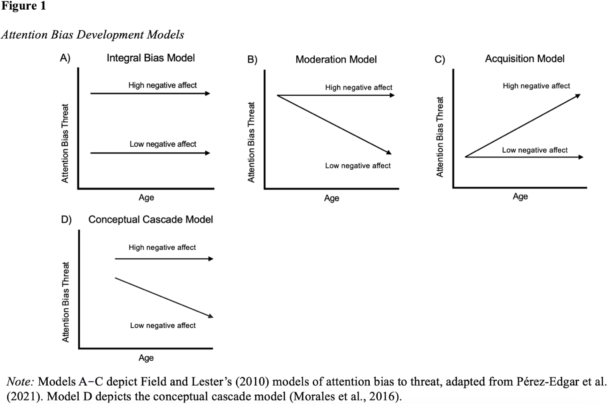
Background
Aim: To investigate whether infant attention bias to threat was longitudinally associated with
childhood anxiety symptoms, and whether this relationship was moderated by
temperamental negative affect.
Notes:
it was hypothesised that there would be a relationship between attention bias to threat (i.e., higher attentional engagement) and later childhood anxiety symptoms and diagnostic severity, which would be moderated by infant temperamental negative affect.
Specifically, among infants with a greater attention bias to threat, it was hypothesised that those with higher levels of temperamental negative affect would show significantly more anxiety in childhood compared to those with lower temperamental negative affect. In contrast, it was hypothesised that among infants with lesser attention bias to threat, there would be no significant difference in childhood anxiety outcomes for those infants with higher or lower temperamental negative affect.

Slide 6
Method
Participants
  94 mother-infant dyads
    Mother age at baseline: 19.53 to 43.46 years (M = 32.39 years, SD = 4.48)
    Infant age at baseline: 3.45 to 13.14 months (M = 7.91, SD = 3.34; 50 female)
    18.2% of the sample were living in areas classified within the lowest two deciles, indicating greater disadvantage.

Slide 7
Method
Measures & Procedure
Infant Negative Affect
Early Childhood
Infancy
Attention Bias to Threat on the Baby Dot Probe Task
Anxiety Symptoms

Slide 8
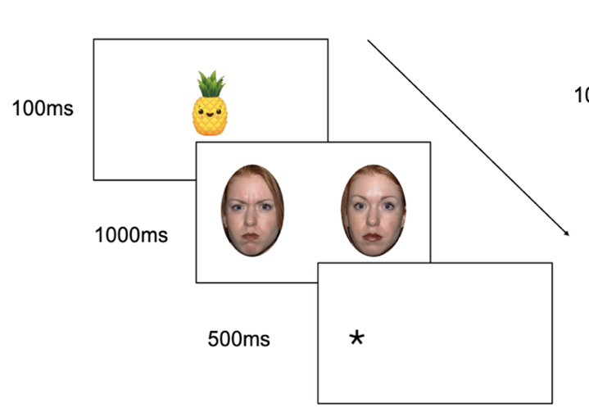
Method
the Baby Dot Probe Task (Perez-Edgar et al., 2017)
Notes:
Focusing on engagement in this study

Slide 9
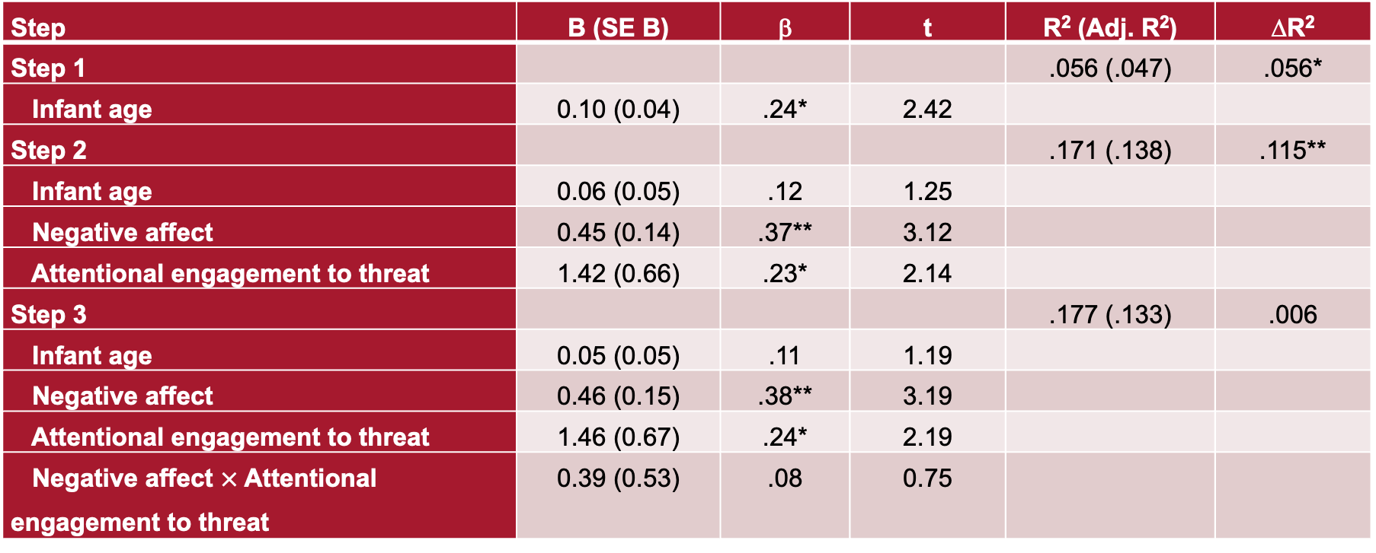
Results
Outcome Variable: Anxiety Symptoms (N = 84)
Step | B (SE B) | β | t | R² (Adj. R²) | ∆R²
Step 1 |  |  |  | .056 (.047) | .056*
Infant age | 0.10 (0.04) | .24* | 2.42
Step 2 |  |  |  | .171 (.138) | .115**
Infant age | 0.06 (0.05) | .12 | 1.25
Negative affect | 0.45 (0.14) | .37** | 3.12
Attentional engagement to threat | 1.42 (0.66) | .23* | 2.14
Step 3 |  |  |  | .177 (.133) | .006
Infant age | 0.05 (0.05) | .11 | 1.19
Negative affect | 0.46 (0.15) | .38** | 3.19
Attentional engagement to threat | 1.46 (0.67) | .24* | 2.19
Negative affect $×$ Attentional engagement to threat | 0.39 (0.53) | .08 | 0.75
Note: *p < .05, **p < .01, ***p < .001
Notes:
As shown in the final model, there was a significant main effect for negative affect (B = 0.46, SE = 0.15, β = .38, t(75) = 3.19, p = .002, 95% CI [0.17, 0.75]). On average, participants with higher temperamental negative affect in infancy showed significantly more anxiety symptoms in childhood than those with lower temperamental negative affect.
There was also a significant main effect for attention engagement (B = 1.46, SE = 0.67, β = .24, t(75) = 2.19, p = .032, 95% CI [0.13, 2.79]). On average, participants with greater attentional engagement towards angry faces in infancy showed significantly more anxiety symptoms in childhood than those with lesser attentional engagement. There was no significant interaction between negative affect and attentional engagement (B = 0.39, SE = 0.53, β = .08, t(75) = 0.75, p = .458, 95% CI [-0.66, 1.44]).
Note: B (SE B) = unstandardised regression coefficient and standard error. β = standardised regression coefficient. ∆R² = R-squared change. *p < .05 **p < .01 ***p < .001. Predictors were mean-centred. B = unstandardized coefficient; SE = standard error. Anxiety symptoms were square-root transformed.

Slide 10
Discussion
Children with greater attentional engagement towards angry faces in infancy showed significantly more anxiety symptoms in childhood than those with lesser attentional engagement.
  Aligning with literature linking attention bias to threat and the development of fear
Compared to children with lower negative affect in infancy,
  Children with higher negative affect in infancy had more anxiety symptoms in early childhood.
Contrary to expectations: The relationship between attention bias to threat and later anxiety symptoms was not moderated by infant negative affect.

Slide 11

Implications
Findings support Integral Bias Model
These findings extend the literature by demonstrating that both temperament and early attention processes independently contribute to later anxiety risk.

Slide 12
Looking for Threat: Examining Whether Infant Attention Bias and Temperament Are Longitudinally Associated with Childhood Anxiety
FRANCES DOYLE
Frances.doyle@mq.edu.au

Slide 13
Method
measures
Infant Temperamental Negative Affect
  12-item Negative Emotionality Subscale (M = 4.31; SD = 1.13) of the Infant Behaviour Questionnaire Revised - Very Short Form (IBQ-R VSF; Putnam et al., 2014).
  Mothers rated the frequency that they observed specific infant behaviours over the past 7 days using a seven-point Likert Scale (1 = never, 7 = always).
  Cronbach’s α was .80
Baby Dot-Probe Task
Attentional engagement was indexed by dwell time on angry versus happy faces during emotional trials (e.g., angry-neutral vs. happy-neutral) (Sareen et al., 2022).
The mean dwell time on angry faces in angry-neutral trials was subtracted from the mean dwell time on happy faces in happy-neutral trials.
Higher dwell time on angry faces indicated greater attentional engagement with threat.

Slide 14
Method
measures
Toddler Anxiety Symptoms
28-item mother-report Preschool Anxiety Scale (PAS) questionnaire (Edwards et al., 2010).
Mothers rated the frequency of specific behaviours observed in their toddlers over the past 7 days using a five-point Likert Scale (0 = not at all true, 4 = very often true).
A total anxiety symptom score was calculated by summing all items and dividing by the number of items with valid responses.
Cronbach’s α was found to be .88, indicating good internal consistency.

Slide 15
Results
BIVARIATE CORRELATIONS
Variable | Anxiety Symptoms | Anxiety Diagnostic Severity | Infant Age at Baseline | Negative Affect
Anxiety Diagnostic Severity | .57*** | _
Infant Age at Baseline | .24* | .01 | _
Negative Affect | .34*** | .19 | .30** | _
Attentional Engagement to Threat | .13 | -.03 | -.15 | -.22*
Note: *p < .05, **p < .01, ***p < .001
Notes:
Bivariate correlations showed that negative affect was negatively associated with attention engagement, where infants higher in negative affect displayed less attention bias to threat. Although this pattern was unexpected, an alternative explanation is that infants high in negative affect may be showing an avoidance of threat. Such avoidance tendencies are consistent with cross-sectional data that shows that infants may orient more to happy faces than angry faces (Aktar et al., 2022), as well as with meta-analytic evidence of vigilance followed by avoidance patterns in anxious youth (Lisk et al., 2020). Conceptually, this aligns with the cognitive-behavioural models of anxiety, which emphasise avoidance as a central factor in the maintenance of anxiety disorders (Barlow, 2004).

Slide 16
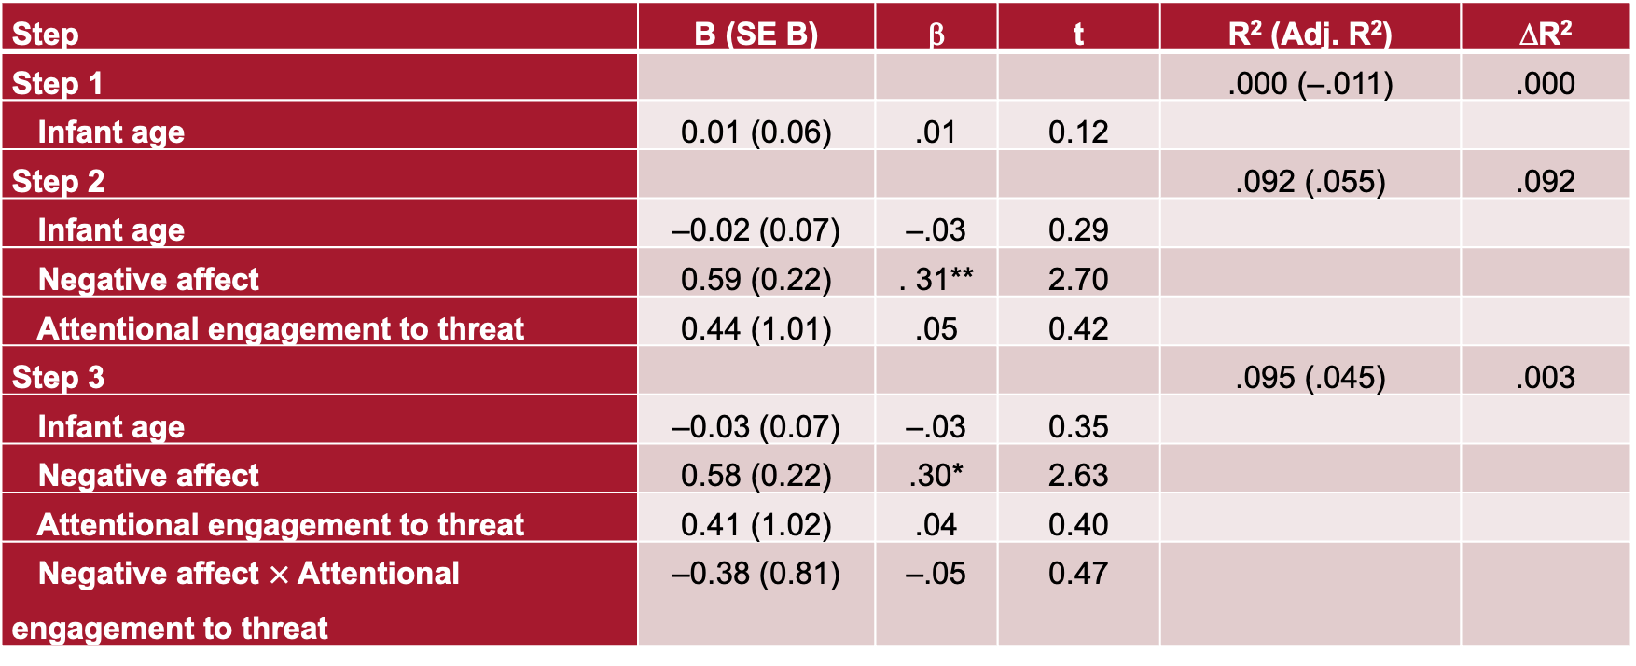
Results
Outcome Variable: Anxiety Diagnostic Severity (N = 77)
Step | B (SE B) | β | t | R² (Adj. R²) | ∆R²
Step 1 |  |  |  | .000 (–.011) | .000
Infant age | 0.01 (0.06) | .01 | 0.12
Step 2 |  |  |  | .092 (.055) | .092
Infant age | –0.02 (0.07) | –.03 | 0.29
Negative affect | 0.59 (0.22) | . 31** | 2.70
Attentional engagement to threat | 0.44 (1.01) | .05 | 0.42
Step 3 |  |  |  | .095 (.045) | .003
Infant age | –0.03 (0.07) | –.03 | 0.35
Negative affect | 0.58 (0.22) | .30* | 2.63
Attentional engagement to threat | 0.41 (1.02) | .04 | 0.40
Negative affect $×$ Attentional engagement to threat | –0.38 (0.81) | –.05 | 0.47
Note: *p < .05, **p < .01, ***p < .001
Notes:
there was a significant main effect for negative affect (B = 0.58, SE = 0.22, β = .30, t(72) = 2.63, p = .012, 95% CI [0.13, 1.02]). On average, participants with higher temperamental negative affect in infancy showed significantly more anxiety diagnostic severity in childhood than those with lower temperamental negative affect. There was no significant main effect for attention engagement (B = 0.41, SE = 1.02, β = .04, t(72) = 0.40, p = .712, 95% CI [-1.66, 2.42]), and no significant interaction between negative affect and attentional engagement (B = -0.38, SE = 0.81, β = -.05, t(72) = -0.47, p = .641, 95% CI [–1.99, 1.23]).

